Slide 1
Feedback-based quantum algorithm inspired by counterdiabatic driving

Slide 2
FALQON: A quantum Lyapunov control
One can choose

Slide 3
Motivation
The fully quantum FALQON algorithm requires a deep circuit and is beyond the scope of NISQ devices
For a smaller circuit size, it remains far from the ground state and can be used to seed QAOA (FALQON+)
Here we explore the effect of counterdiabaticity in the context of FALQON, and demonstrate that operators from the counterdiabatic pool of operators decrease the energies much faster and can be used to seed a much smaller depth quantum circuit
Multicontrol FALQON
We look for the effect of adding another term in the control Hamiltonian
Effectively the FALQON algorithm solves:
Where a’s are amplitudes in the eigen basis of Hp.
This equation do not take the energy differences into account (in the coupling term) and can we introduce such a coupling term to effectively drive??

Slide 4
Counterdiabatic operator
Adiabatic context:
Approximate gauge potential:
This potential can be expressed as a linear combination
of basis operators from a pool of operators

Slide 5

Hamiltonian
1D Ising model:
Three cases:
J=-1, hz=-0.4, hx=-0.4 (Mixed)
J=-1, hz=-0, hx=-0 (ground state is a GHZ state)
J=-1, hz=-0, hx=-0.4 (Transverse field Ising model)
Pool of operators have the form:
$U_{k}=U_{P}U_{M}(β_{k})U_{CD}(γ_{k})$, $U_{M}(β_{k})$=$e^{−iH_{M}β_{k}dt}$ , $U_{CD}(γ_{k})$= $e^{−iH_{CD}γ_{k}dt},$ $U_{P}$= $e^{−iH_{P}dt}$
We will consider N=6

Slide 6
J=-1, hz=-0.4, hx=-0.4 (Mixed)
YZ
FALQON
Y

Slide 7
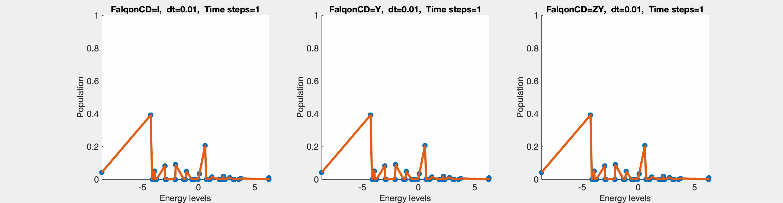
J=-1, hz=-0.4, hx=-0.4 (Mixed)

Slide 8
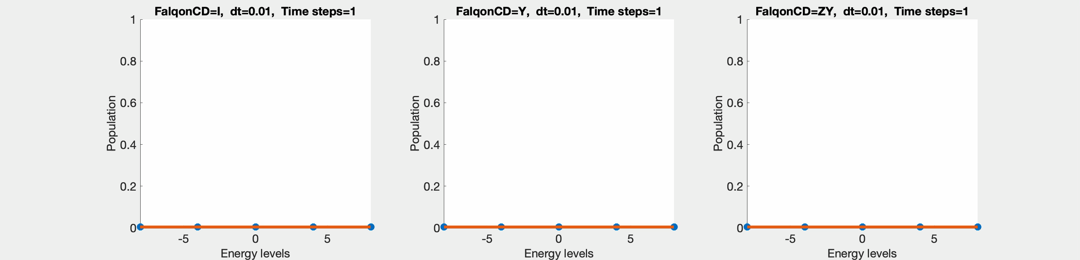
J=-1, hz=-0, hx=-0 (GHZ ground state)
FALQON
Y
YZ

Slide 9
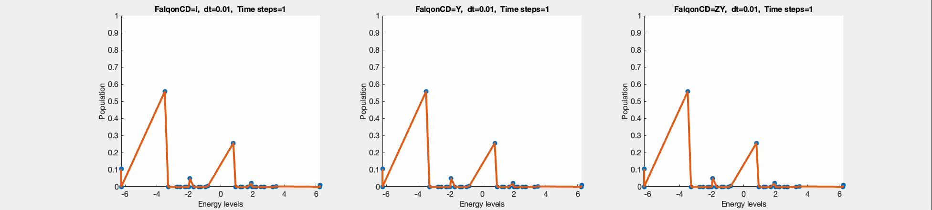
J=-1, hz=-0, hx=-0.4 (TFIM)
FALQON
Y
YZ

Slide 10
Conclusion
We show that for a small evolution time counterdiabatic inspired FALQON transfers population to the low energy levels much faster than the original FALQON
However, this method leads to a platue, and the population transfers slows down after a finite time
Even though we do not get ground state in many cases, we can still use this as a new initial state since the ground state population is higher than the chosen initial state.
This can be used to seed the CD-QAOA, where the initial parameters can be taken from the beta and gamma values.
We also agree with and can demonstrate that how certain CD operators are better than the others

